Slide 1


SMART INDIA HACKATHON 2024
Basic Details of the Team and Problem Statement
Problem Statement ID –1666
Problem Statement Title- Develop Effective Career Counselling and Guidance Programs in Schools to Enhance Student Career Choices
Theme- SMART EDUCATION
PS Category- Software
Team ID- 38586
Team Name (Registered on portal): InnoVenturee

Slide 2
Students’ Hub
InnoVenturee
Empowered Students, Brighter Futures.
Proposed Solution:
OUR APP IS DEDICATED TO:
For Students: Psychometric tests using AI are being used to determine students' interests, strengths, and personality qualities, providing tailored career suggestions based on these results. The app informs learners about future career features in both Academics and Non-Academics (music, fine arts, etc.) , admission tests, and materials to support their chosen path. Starting in eighth grade, the app offers a library with links to books, articles, and other materials to help students develop their strengths and prepare for their chosen career.
For Teachers: Teachers may organize workshops and seminars to assist students in making career decisions. Connect with mentors for offline seminars for career counselling.
ISSUES FACED BY STUDENTS
Lack of Self-Awareness: It can be challenging for many students to select a job path that fits their personality and aspirations since they are unaware about their interests, abilities, and weaknesses.
Lack of Information:
WHY US?
We aim to maximize each person's potential and offer professional possibilities in all major professions, including academics, sports, the arts, and other areas of study, so they can secure a bright future.
For Mentors: One-to-one connection with Parents and Students. Can conduct offline seminars for schools.
Making smart selections can be challenging for students when they lack access to sufficient or correct information about various career routes, school options, or the job market.
Our app mainly focuses on providing clarity to students on the above aspects
Gamified Skill Development: Introduction to gamification elements where students can earn points and badges for completing skill-building activities, attending workshops, or participating in career-related challenges. This can make learning more engaging.
Community Forums: Creating a space for students to discuss career-related topics, share experiences, and ask questions. This can foster a sense of community and support among users.
Career Goal Tracker: A goal-setting app specifically for career aspirations. Students can set short-term and long-term goals, track their progress, and receive reminders and motivational content to stay on track.
Students are the highest priority of our app

Slide 3
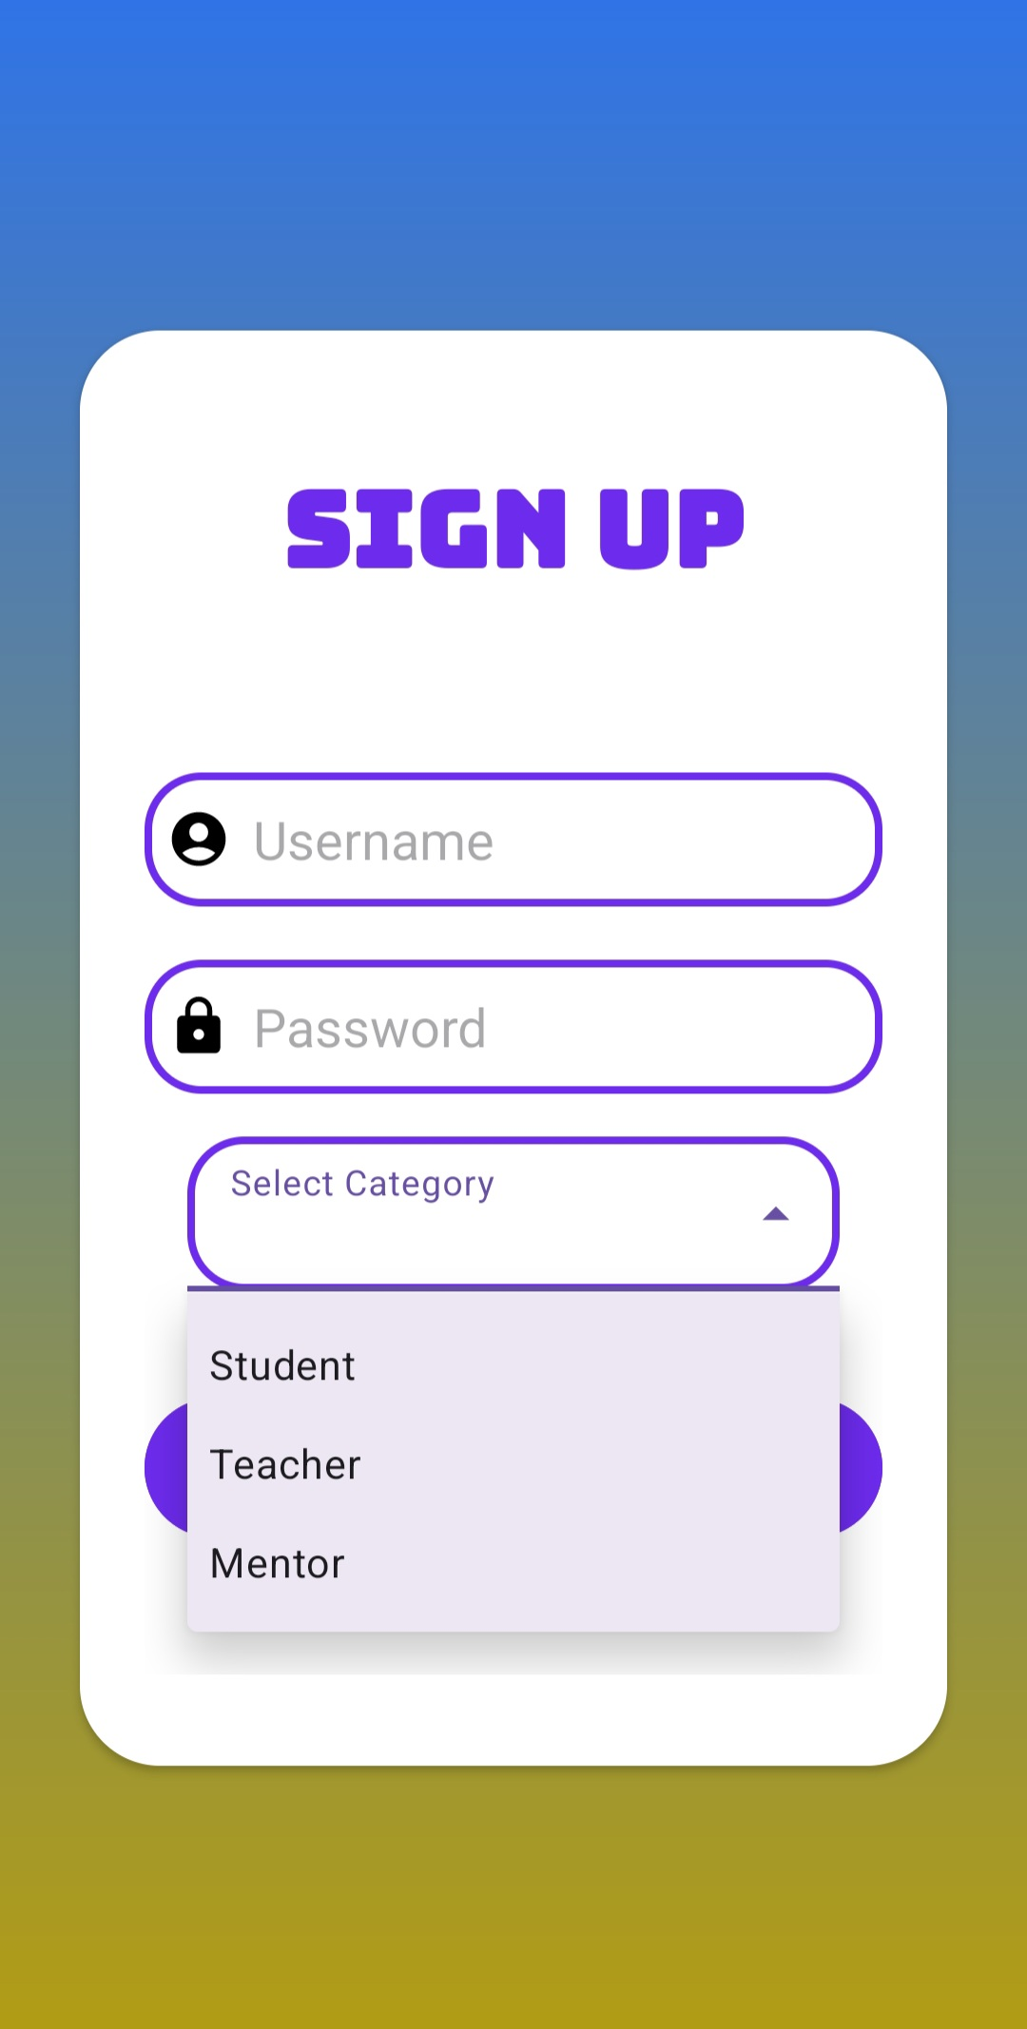
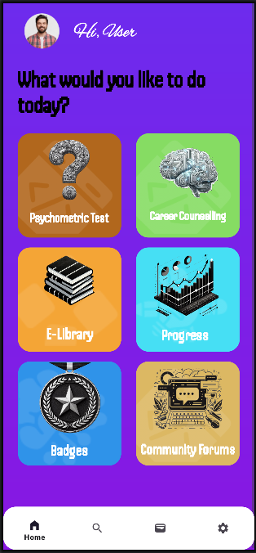
TECH STACK
InnoVenturee
Programming Languages: Python, Java, XML and JS,CSS,HTML
Framework: ExpressJS, MongoDB
Database: MySQL, Firebase
Methodology and process for implementation:
Source code of prototype:
Android Application: https://github.com/ankit2061/Student_Hubs
Website: https://github.com/archisman-05/Student-s-Hub
Technology Stack Selection Backend: We will be utilizing Python libraries like TensorFlow, or PyTorch for building the AI model capable of analyzing user data and providing personalized career recommendations. Employing ExpressJS for developing a robust and scalable backend framework, handling API requests, data management, and integration with other components. We will be using Java and JS for backend of android application and website respectively.
Frontend: We will be creating an intuitive and visually appealing user interface using these web technologies using HTML, CSS for website and XML for UI design of the android application. Also using a frontend framework like React or Angular for enhanced development efficiency and component-based architecture.
Backend Development:
API Design: Defining RESTful APIs to handle user interactions, personality test submissions, career recommendations, and connections to mentors and libraries.
Database integration: We would implement a suitable database (e.g., MySQL, PostgreSQL) to store user data, test results, and recommendation history. Also we will be using Firebase for authentication, hosting and performance monitoring.

Slide 4
FEASIBILITY AND VIABILITY
InnoVenturee
Market Analysis
The need for individualized career counselling is growing as students increasingly seek professional pathways beyond academics. Current platforms are often overly broad and expensive, focusing on academic sectors. An app that covers all sectors efficiently could help reduce this gap. It could use personality assessments, AI algorithms to suggest career paths, connect students with professionals or alumni for mentorship, and provide resources to explore different careers. Features could also allow students to set and track career-related goals.
Potential Risks and Challenges
Ensuring the app is technically robust, with minimal downtime and bugs.
Securing funding and maintaining the app's financial viability over time.
Strategies for Overcoming These Challenges
We aim to provide regular updates, thorough testing, and a responsive technical support system.
We are developing a clear business model, exploring various funding sources, and considering cost-sharing with educational institutions.
Technical failures could disrupt services, leading to frustration and a lack of trust in the app.
The app may not be sustainable if costs outweigh benefits or if funding sources dry up.
We are developing a clear business model, exploring various funding sources, and considering cost-sharing with educational institutions.

Slide 5

IMPACT AND BENEFITS
InnoVenturee
POTENTIAL IMPACT ON THE TARGET AUDIENCE:
Increased Access to Resources: Students have access to an extensive array of tools, including career evaluations(including both academics and non-academics), skill-building activities, and job market trends, all of which contribute to the career planning process.
2. Early Exposure: Early career exploration in various fields enables students to better prepare for the job market in both academic and non-academic by enabling them to match their interests with their career aspirations.
Equal Access to Opportunities: The app can lessen inequality by leveling the playing field for students from various backgrounds by offering tools and guidance.
Education Cost Savings: Students can save time and money by making well-informed judgments regarding their career and avoiding pointless courses or degrees.
Economic Growth: A well-guided workforce is more efficient and innovative, contributing to overall economic growth.
BENEFITS OF THE SOLUTION (SOCIAL, ECONOMIC, ENVIRONMENTAL, ETC.):
A
1
2
B
1
2
3

Slide 6
RESEARCH AND REFERENCES
InnoVenturee
DETAILS / LINKS OF THE REFERENCE AND RESEARCH WORK
https://www.thehindu.com/education/the-role-of-artificial-intelligence-in-career-counselling/article68275874.ece
https://www.educationtimes.com/article/campus-beat-college-life/99734241/career-counselling-can-help-stop-student-suicides-in-india
https://pin.it/eFXFVh70A
https://www.indiatoday.in/education-today/featurephilia/story/importance-of-career-counselling-for-a-smooth-transition-in-digital-age-2546071-2024-05-31
https://www.linkedin.com/pulse/career-counselling-india-unlocking-success-remarkable-education/
https://www.indiatoday.in/education-today/news/story/93-indian-students-aware-of-just-seven-career-options-what-are-parents-doing-wrong-1446205-2019-02-04
https://www.hindustantimes.com/health-and-fitness/do-what-you-love-career-choices-made-early-in-life-impact-health-later/story-OOenID4pRR6oMNEKjn2UtI.html
https://www.indiatoday.in/education-today/featurephilia/story/are-wrong-career-choices-to-blame-for-the-low-happiness-index-in-india-2291127-2022-10-30
https://economictimes.indiatimes.com/jobs/nearly-85-of-higher-education-candidates-not-equipped-to-take-career-decisions-survey/articleshow/62636443.cms?from=mdr

